Slide 1
Placement Management System
PROJECT BY
Miss. Nikita Gokharkar
GUIDED BY:
Miss. Shalini Kumari
(Technical Trainer)
Java Full-Stack Development
Edubridge

Slide 2
Contents
Introduction
Objectives
Scope
Problem Definition
Advantages
Requirement Specification
Output
Conclusion

Slide 3
Introduction
Every Training and Placement Management System has different training needs, therefore we design exclusive Placement Management System that are adapted to your managerial requirements.
The “Placement Management System” has been developed to override the problems prevailing in the practicing manual system.
In this we can create new profiles of students, edit and delete them as per our convinence.
The data which is entered is saved in the database.

Slide 4
Objectives
To reduce the manual work
To manage the details of Registration, Placement.
To give access only for the Administrator
To keep record of all user details and placements

Slide 5
Scope
Students can access previous information about placement.
We can stores information of all students.
Various companies can access their information.
Notifications are sent to students about the companies.

Slide 6
Problem Statement
Students choose a specific college where the placement will be held, there is a need to maintain all these papers, causing large amount of space.
It is manually done, chances of missing, difficult to handle the details of student.

Slide 7
Advantages
Placement officer can easily collect student’s details and approve the details provided by them.
As it is an online application, communication with placement officer is easy to students and recruiters, so here intimating about new placements very easy task.
Here recruiters can also search for the details provided by students on the basis of their percentage.
Placement officer can send required materials used for placements preparation to students.

Slide 8
Requirement Specifications
Software Requirements | Language Used
Eclipse IDE | Java
MySQL Workbench 8.0 CE | HTML
 | CSS
 | Spring Boot
 | MySQL

Slide 9
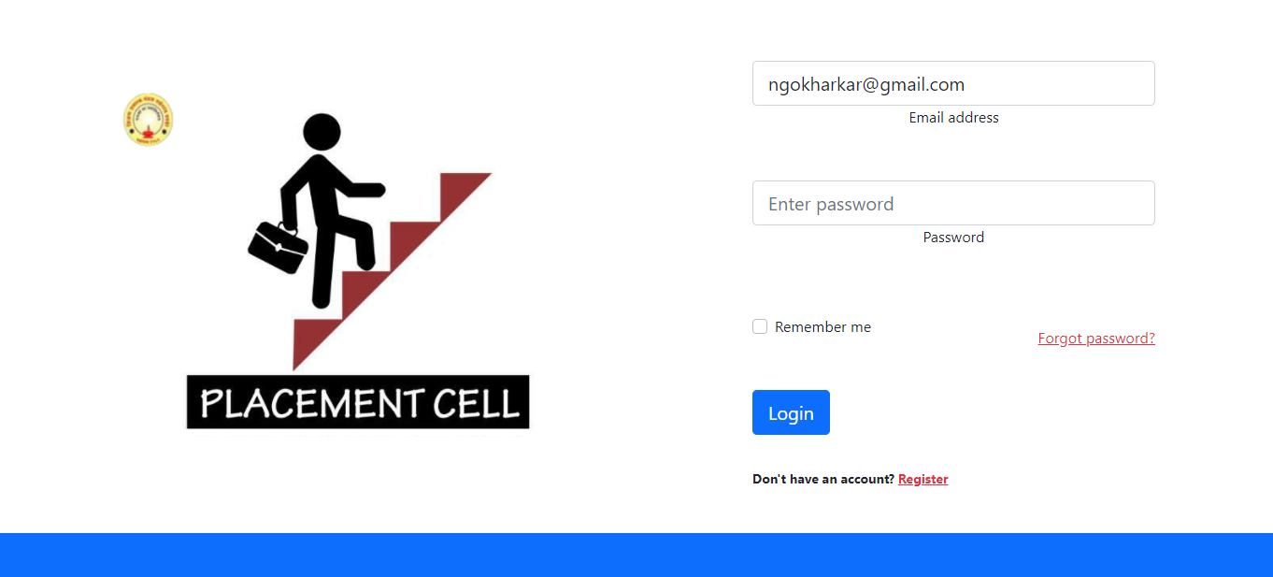
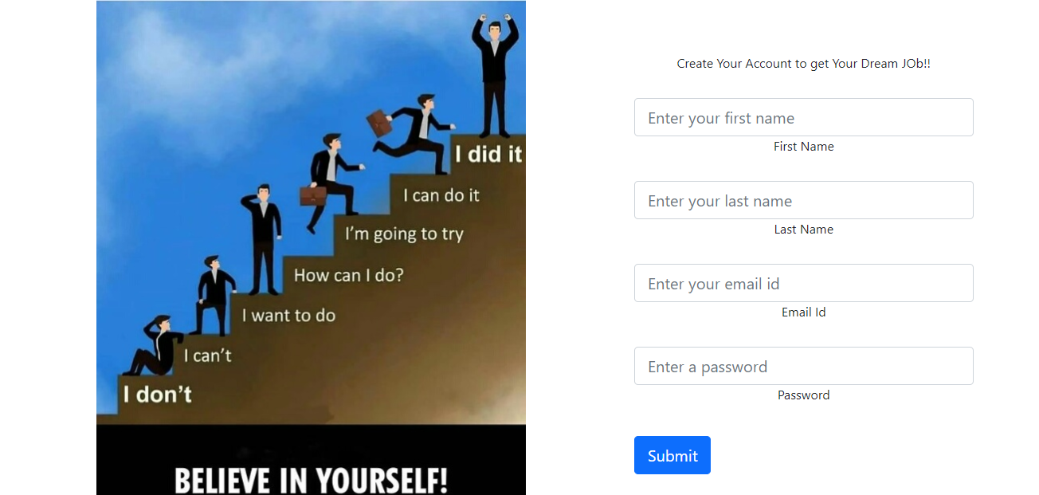
Output

Slide 10
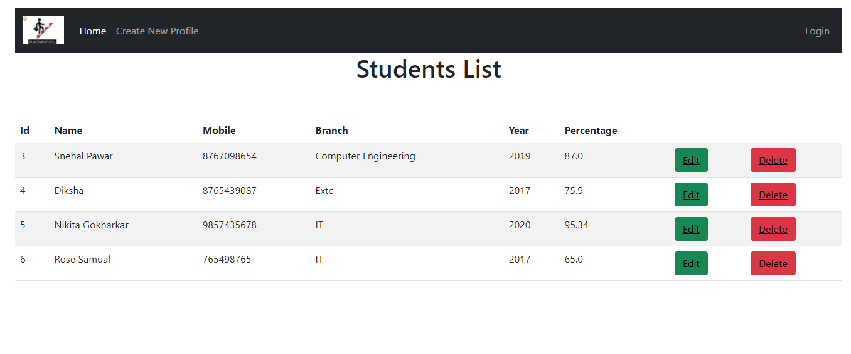
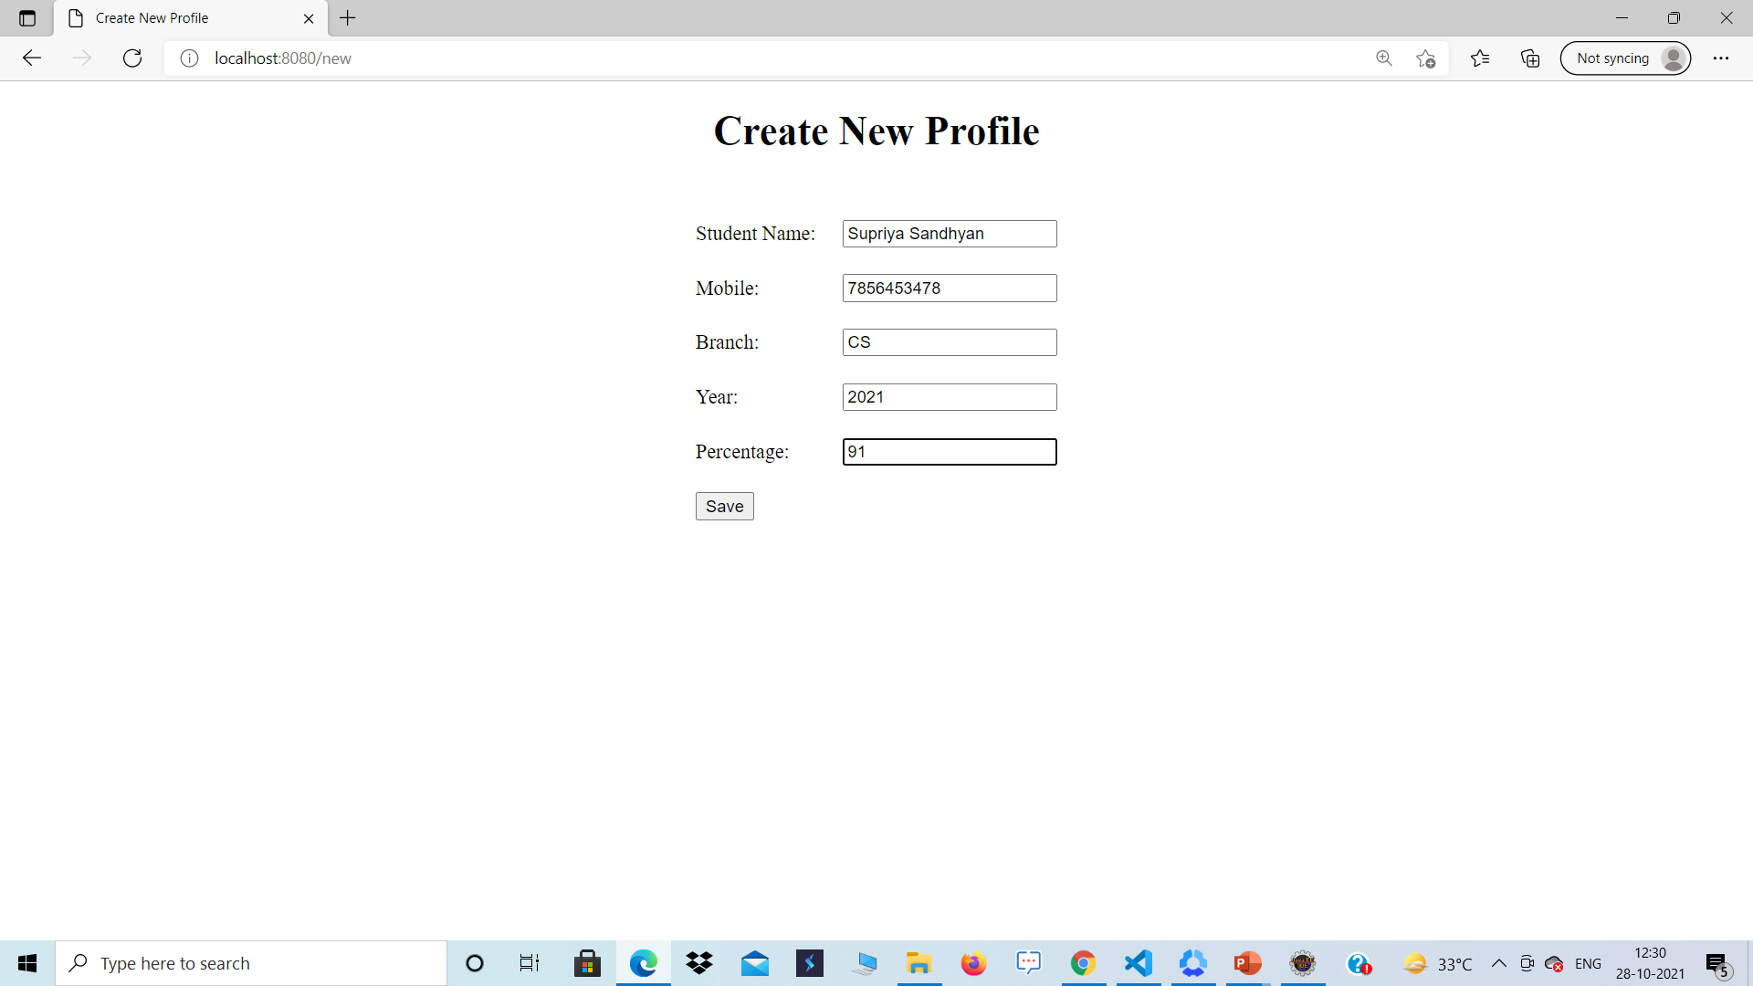

Slide 11
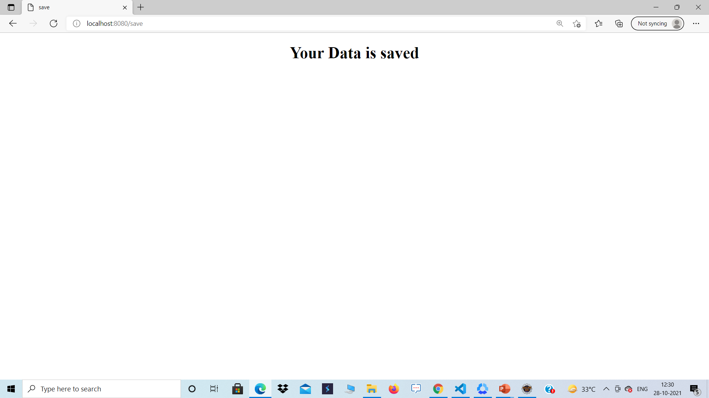
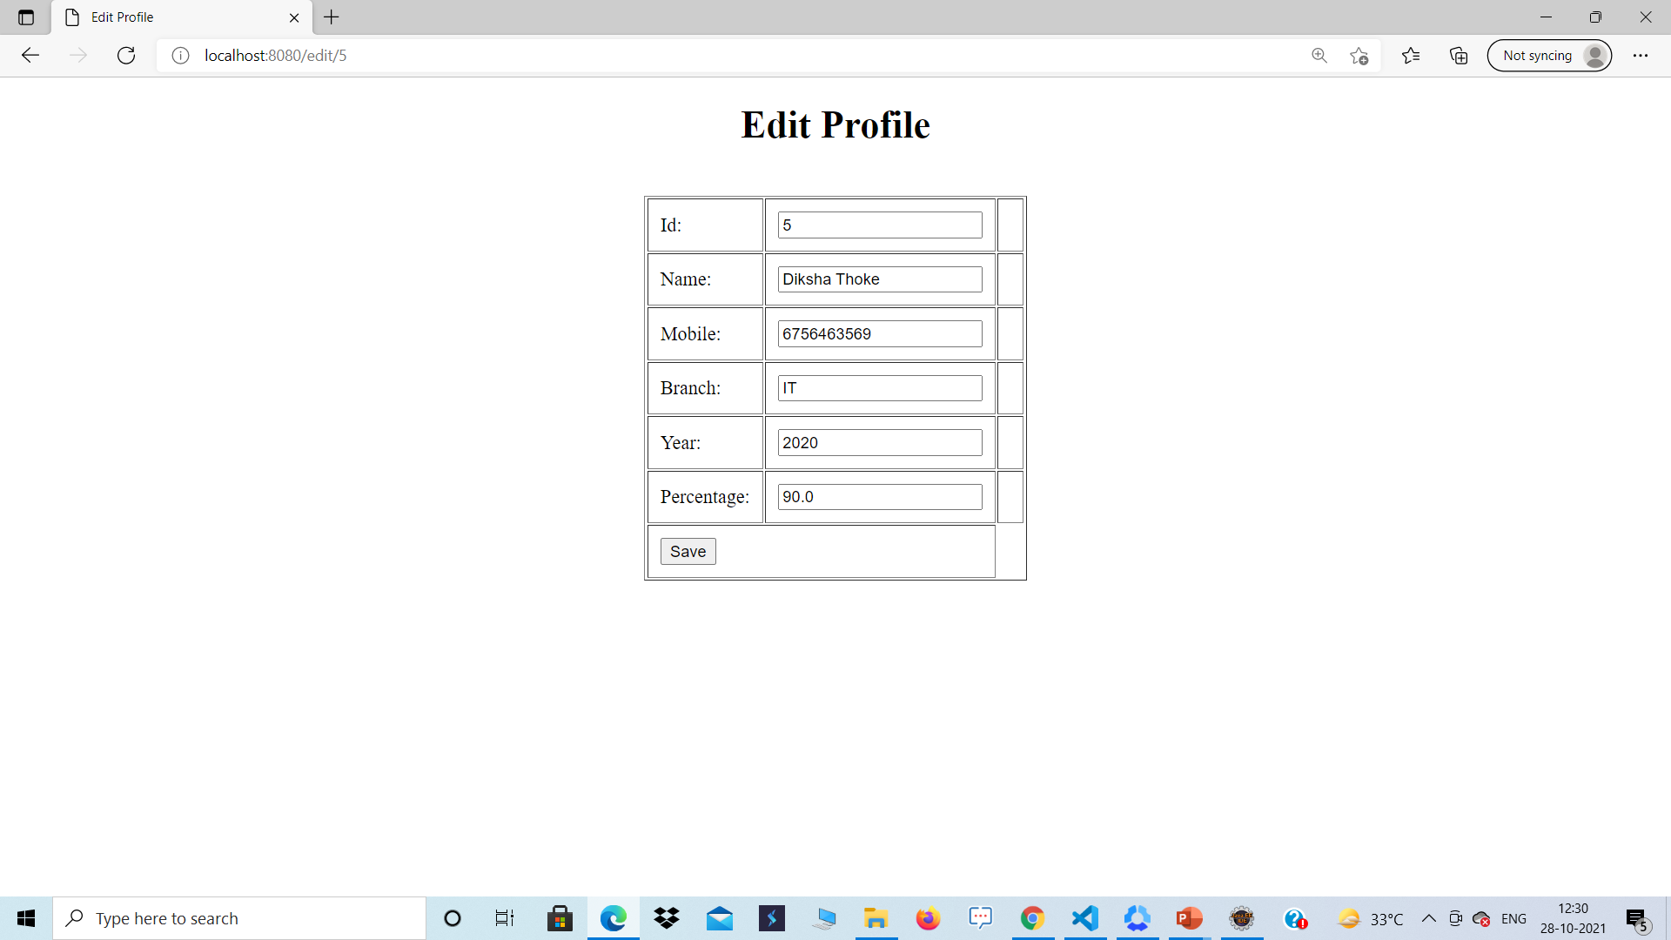

Slide 12
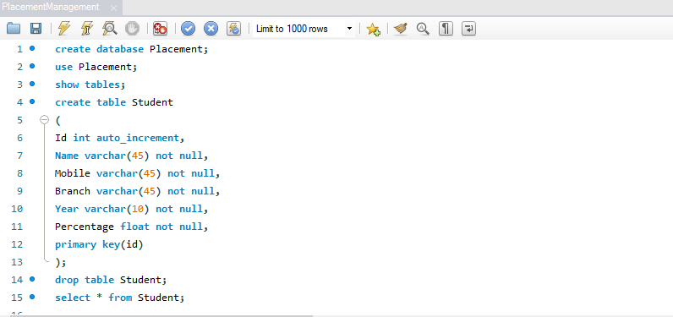
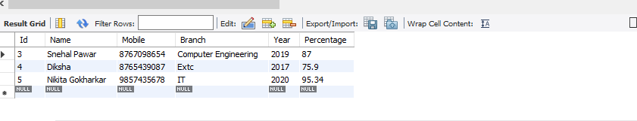

Slide 13
Conclusion
From the proper analysis of positive points and constraints on the component, it can be safely concluded that the system is highly efficient GUI based component. This system is user friendly. Generally the TPO’s of the Colleges has to face a lot of problems in management of the students information. This all information has to be managed manually. So, there is a need to develop a system that can solve the mentioned problem. This system comes with just that solution.

Slide 14
Thank You

